Slide 1
VA Benefits
for CG Personnel
Things to Know & Actions Required
to Apply for Disability Compensation

Slide 2
This is all open source material
Before starting, here is your first homework assignment: HW #1
  1) Take out phone, if not already out.
  2) Go to Google and type “VA Know”.
  3) Hit the link for M21-1 Adjudication…
  4) Start exploring the topics/search bar
  HW #2
  Build your VA literacy for yourself and share/teach three others not here today.

Slide 3
VA - Organization
Veterans Benefits Administration
  All VA benefits - Compensation, Education,
  Home Loans, Voc. Rehab, Survivor benefits etc.
  VBA Regional Offices (Buffalo, St Pete, San Diego)
Veterans Health Administration
  All VA health care services
  VA Medical Centers: (VAMC Hampton)
  Community Based Outpatient Clinics (CBOC VA Beach)
National Cemetery Administration
  National and State Veterans Cemeteries
  Headstones/Markers & Medallions for private cemeteries
  Presidential Memorial Certificates

Slide 4
Common Terms and Acronyms – 1 of 3
VSO/VSR: Veteran Service Officer or Veteran Service Representative – Folks to help you file and answer “?s”
VSO: Veteran Service Organization – The big ones include AL, VFW, DAV, and the small ones include: MOPH
POA: Power of Attorney – Can help with claims and can be family/VSO/Law Firm (Firm’s fee? usually 33% of retro.
  A family member can be your POA, must reapply each claim.
Fiduciary: If Veteran needs additional help: dementia/MH/SC Injuries preventing competency (usually a family member).

Slide 5
Common Terms and Acronyms - 2 of 3
Intent to File: “I will file a claim within one year” – This holds a retroactive date, if the rules on “time allowed” are met, your accrued “$$” is recorded from an earlier date, a date before your date of claim.
DOC/Date of Claim: This is the date that the claim is officially received by the VBA. All uploaded/scanned/faxed docs receive an official VA time stamp.
“What if I drop off my documents at my POA/VSO at their office, does that count?” NOPE, my new best suggestion is to try to submit your documents/forms online. I found it to be very useful.

Slide 6
Common Terms and Acronyms - 3 of 3
Contention: What you “contend” is each issue that you’re claiming, this can be back pain, sleep apnea or a newborn.
Dependency: 30% can add deps to award, including step/adopted children and even parents (typically not worth it)
Event date: Date when activity happens that impacts disability compensation (birth/marriage date, date docs submitted at +1yr)
Effective date: the 1st day with new $$, which is typically….
First of the following month: Actions/events accrued in current month are compiled and paid on the 1st of the following month.
Following this model: The VA publishes new Calendar Year disability rates, effective on Dec 01, 2022, for Jan 01, 2023.

Slide 7
VSO’s-Veterans helping Veterans (Typically)
Veteran Service Officers are VSO employees
VSO’s have clearance & training to review your STR’s & submit/monitor your claim in VBMS
VSO’s may be contracted by State Dept. of Veteran Affairs to process disability claims in rural areas and serve as the County Veteran “Agent”.
Form: 21-22 – Makes a VSO your POA. Not permanent, notifies VA to allow their access. There are privacy provisions to limit some VSO access.

Slide 8

VSO’s-Veterans helping Veterans Continued
  Time for some due diligence on your own behalf:
  Test them with a phone call. Do they reply in a few days?
  Try an email, what is the response time?
  Visit their office. Is it organized? Do they have a multi-function copier/scanner to electronically send your docs?
  Can each computer monitor double as a flower press?
  Also search for state level VSOs, they can help you as well.

Slide 9
Compensation
A service-connected disability is a disease or injury incurred or aggravated while on active duty. The disability does not have to be combat, or wartime related.
Notes:
How many of you have been in heavy seas, maybe wearing body armor, before those 10 thousand dollar bouncy seats were around? How is your back pain these days? How are your knees and ankles?

Slide 10
Service Connected (SC) Disability
Disability Listing Do’s and Don’t
For Knee or Back say: “Knee pain”, “Back condition”
List injuries/Illnesses/allergies from your AD or within 1 year
Don’t play MD with SC injuries. Unless an MD entered it in your Service Treatment Record (or referral sent in notes)
If an MD wrote “ACL”, then “ACL” is fine. But you feeling your knee hurt, you call it knee pain and go get it treated on AD.
PTSD – Includes MST (personal trauma) and fear based
NEW! PACT Act expansion of presumptive illnesses including Sinusitis & Rhinitis. If you were in the Sandbox, have symptoms & you claim it. It granted as presumptive.

Slide 11
(SC) Disability Continued
Your claim will take months to process, even with all STR/PMR evidence submitted.
Then you’ll have one or more C&P exams. This is NOT a normal visit to the Dr.
Rating decisions are P&T (Static) or Routine Future Exam (RFE). Typically for sleep apnea, prostate cancer, PT consults.
Disabilities are rated from 0% to 100%
0% ratings are not denials, ie: four 0% ratings are rated at 10%*
Payments begin with a 10% rating and round up (95% gets 100%)
Notes:
* Not a normal MD visit

Slide 12
Compensation-Sample Rates
Rating | Vet Only | Vet+S | Vet+S+1C | Child 0-18 | 18+ Sch.
10% | 166 | N/A | N/A | N/A | N/A
20% | 328 | N/A | N/A | N/A | N/A
30% | 508 | 568 | 612 | +30 | +97
40% | 732 | 812 | 871 | +40 | +129
50% | 1042 | 1142 | 1216 | +50 | +162
60% | 1320 | 1441 | 1529 | +60 | +194
70% | 1663 | 1804 | 1907 | +70 | +226
80% | 1933 | 2094 | 2212 | +80 | +259
90% | 2172 | 2353 | 2486 | +90 | +291
100% | 3622 | 3824 | 3972 | +100.34 | +324
S=Spouse C=Child(ren) Rates start 12/01/22 & pay 01/01/23
VA rates & SSA COLA rates, both go up 8.7% for CY23
Last year rates went up 5.9% (almost 15% combined)

Slide 13
SC Disability Compensation
SC Disability Compensation is TAX FREE.
Concurrent receipt of retired pay is allowed at 50% or higher SC disability compensation. “DFAS talks to VA”
Do your best math with a tax pro who knows mil. pensions. Do a search in Norfolk, call them to get a referral for your state, then meet them and decide.
When a child of a SC Veteran is 18 thru 23, they can be continued as a schoolchild ($97-$324/month). Except upon entering a service academy or enlisting (Active Duty).
Why a long engagement is best for your schoolchild? If married while in school & under 23, YOU will no longer get the Schoolchild $$ on the first of each month. Same with joining the military, the money stops entering your wallet.

Slide 14
Compensation – Add. Benefits
VA health care for all service-connected conditions. For NSC injuries, higher % = lower copays at the VAMC. Check online
Federal employment pref. (5-10 Pts)
PMI programs, NPS entrance fees, lots of state, county and local discount programs
Potential for reduced state/local property taxes, might be waived for 100% P&T disabled (Possible reductions for combat zone service and/or earning hazard pay)

Slide 15
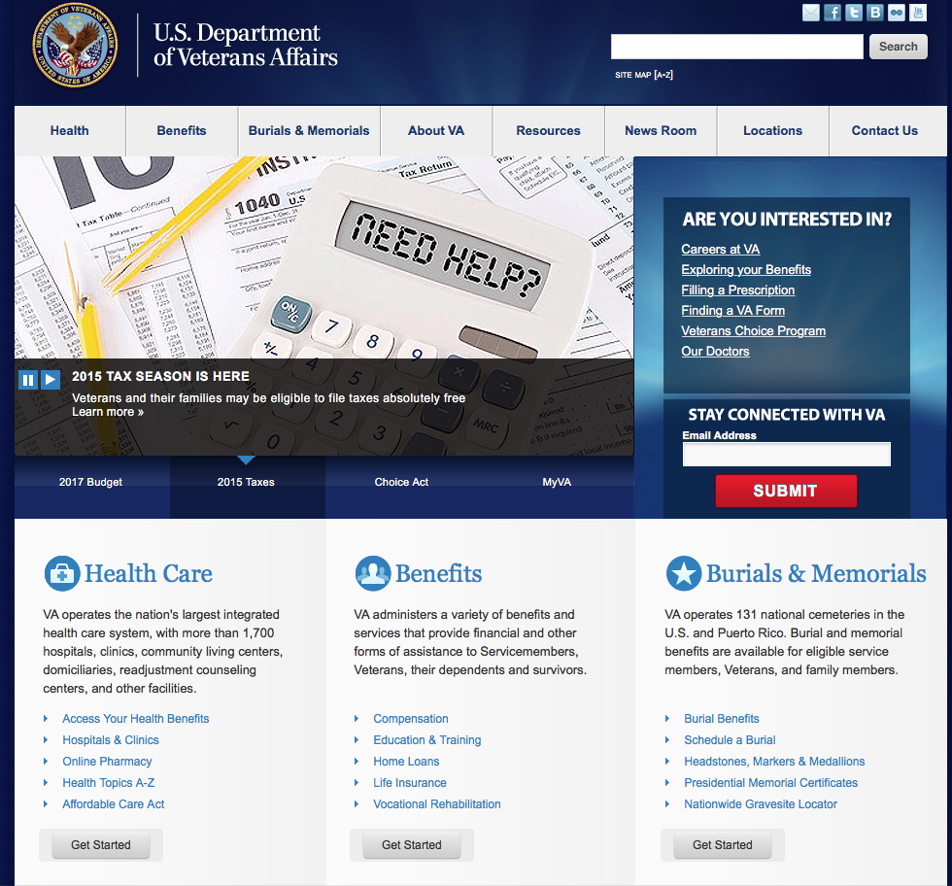
VA.GOV is your 1st step
Notes:
Explore E-Benefits – It is like a library, if you do some searching you will find useful sections.

Slide 16
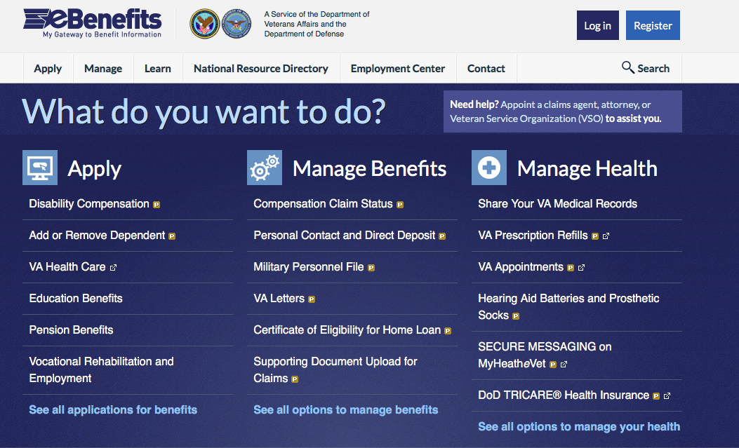
ebenefits.va.gov is your 2nd step

Slide 17
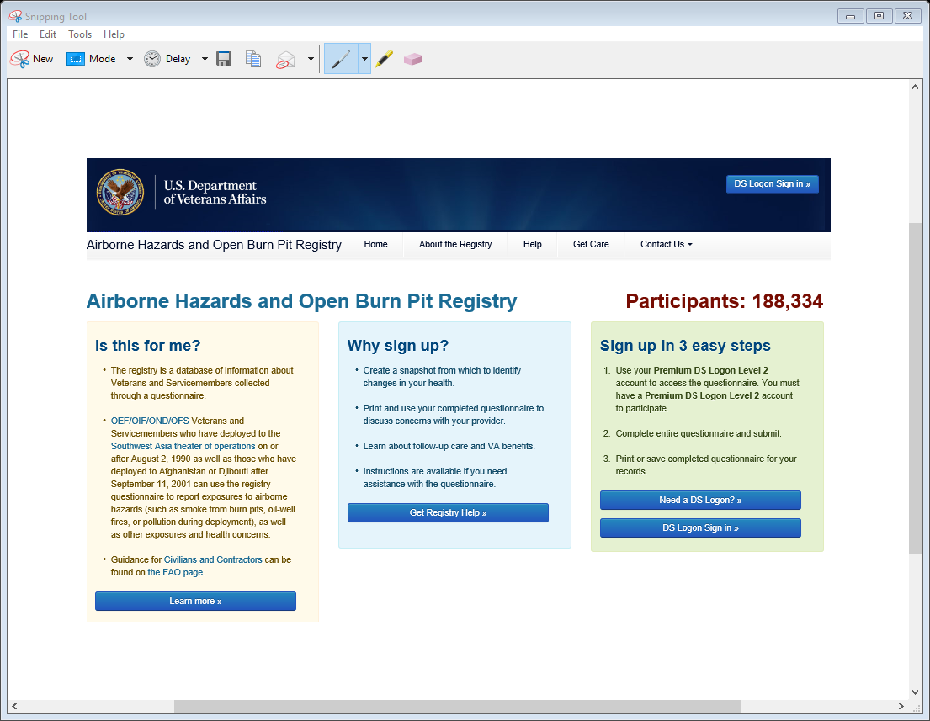
Another site to visit
https://veteran.mobilehealth.va.gov/AHBurnPitRegistry/index.html#page/home
Not just for burn pits.
Containers
Container yards
Vessel Inspections
Military Outload Facilities
Refineries
Tank farms
Places called:
“The Benzene Capital of the World”

Slide 18
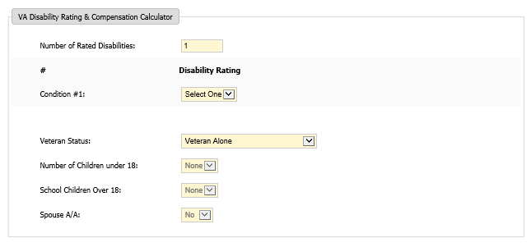
And another site
https://goodcalculators.com/va-disability-calculator/
No promises on how up-to-date the rates are.

Slide 19
Key forms you will use
21-4138 Statement in Support of Claim, you &
Spouse/shipmates use to describe events & impacts of disability. Use to document changes. I always submit one with any faxed/mailed docs.
21-0966 Intent to File a Claim For Compensation
Locks in earlier retro date, provides up to one year to submit a 21-526
21-526 App for Disability Comp. & Benefits
21-686c Declaration of Status of Dependents- In your household. Use to adjust your dep. status for death/divorce. Kids removed at 18 automatically.
Notes:
Lack of understanding about USCG and roles in Deepwater Horizon, Title 14 and role in Title 10 missions.

Slide 20
More forms to Know
21-4142/a For release of Private Medical Records and from Vet Centers. (Excellent facilities and resources)
21-674 Request Approval of School Attendance: Send right before 18th Birthday (high school) For college send right after start of semester.
21-0960-XX Disability Benefits Quest. (DBQ) There are several (think “specialists”) Ex: Cardio, Neurology, Knee. Used for C&P exams at VAMC, used to be public use, but fraud stopped release.
21-0781 PTSD Stressor Questionnaire
Notes:
Lack of understanding about USCG and roles in Deepwater Horizon, Title 14 and role in Title 10 missions.

Slide 21

DOD-Centric VA needs you to give USCG career details to help them realize what you have done and experienced! (The VA understands convoy ops)
Notes:
Out of 425 staff at my office, 3 are CG.

Slide 22

Compensation
To some at VA, this would just be a boat ride – So provide your job details. Clarity of your documentation matters!
Notes:
Small boat – A-Bay

Slide 23
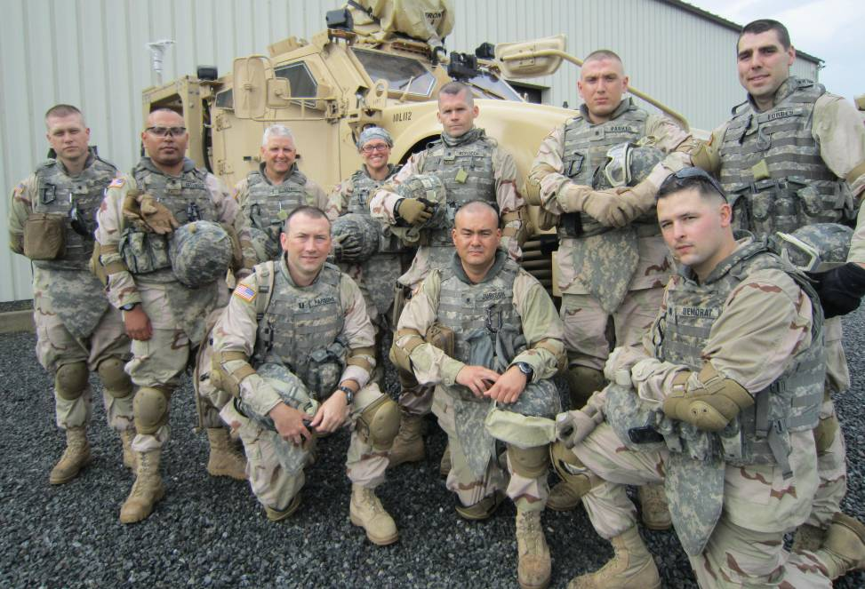


USCG is Unique
Your CG claim might be the first for a VA employee.
You docs will teach them about your experience.
Written descriptions are key: Awards for underway hours and specific actions.
PQS sign offs showing tasks & work. location. Please note “events in service” on a VA Form 21-4138 to support claims.
Make sure your health record is up to date and includes all visits outside of CG clinics: 24-hour clinics, VAMC or DOD Hospitals.
Any diagnosis on active duty is helpful (makes it easy) for the VSR/RVSR (Rating VSR) to have the information needed to justify ordering an exam or just grant a claimed condition as Service Connected.

Slide 24
Some closing guidance:
-Regarding VA knowledge:
There is a lot to learn, give yourself time to learn it.
Teach it to others, so you understand it better.
-Regarding the claims process:
It will be frustrating and it’s going to be ok, if you let it be you new (temporary) “hobby”.
-Regarding retirement:
Start making a list of people to invite to your retirement. I forgot some and felt awful.
Have a retirement ceremony. It is for you so you can say “Thank You”.
Know that you’re not the first and not the last, but for you, it will be your Independence Day.
Lastly, with retirement comes aging, “it isn’t bad if you don’t take it personally.” (Patton Oswalt)

Slide 25
Questions?

